Slide 1
CREDIT CARD
WEEKLY STATUS REPORT
A Power BI Project Presentation by Neha Pal

Slide 2

Project Objective
To develop a comprehensive credit card weekly dashboard that provides real-time insights into key performance metrics and trends, enabling stakeholders to monitor and analyze credit card operations effectively.

Slide 3
Data collection & Understanding
Data Source:
Used secondary data source for data collection like .CSV files.
Dataset Overview:
Credit Card
Dataset Rows: 10,108
Columns: 18
Columns: Client_Num, Card_Category, Annual_Fees, Activation_30_Days,Customer_Acq_Cost, Week_Start_Date, Week_Num, Qtr,current_year, Credit_Limit, Total_Revolving_Bal, Total_Trans_Amt,Total_Trans_Vol, Avg_Utilization_Ratio, Use Chip, Exp Type,Interest_Earned, Delinquent_AccClean dataset with no missing values.
Customer Dataset
Rows: 10,108
Columns: 15
Columns: Client_Num, Customer_Age, Gender, Dependent_Count, Education_Level,Marital_Status, state_cd, Zipcode, Car_Owner, House_Owner,Personal_loan, contact, Customer_Job, Income, Cust_Satisfaction_ScoreClean dataset with no missing values.
Usage:
Both datasets were joined on Client_Num to analyze customer behavior, transaction trends, card performance, and regional insights in
Power BI.

Slide 4
Add new columns using DAX Queries
AgeGroup = SWITCH(TRUE(),
customer[Customer_Age]<30,"20-30",
customer[Customer_Age]>=30 && customer[Customer_Age]<40,"30-40",
customer[Customer_Age]>=40 && customer[Customer_Age]<50,"40-50",
customer[Customer_Age]>=50 && customer[Customer_Age]<60,"50-60",
customer[Customer_Age]>=60,"60+",
"Unknown")
Revenue = credit_card[Annual_Fees]+credit_card[Interest_Earned]+credit_card[Total_Trans_Amt]
Weeknum = WEEKNUM(credit_card[Week_Start_Date].[Date])
IncomeGroup = SWITCH(TRUE(),
customer[Income]<35000,"Low",
customer[Income]>=35000 && customer[Income]<70000,"Mid",
customer[Income]>=70000,"High",
"Unknown")
Current_week_revenue = CALCULATE(
SUM('credit_card'[Revenue]),
FILTER(
ALL('credit_card'),
'credit_card'[Weeknum] = MAX('credit_card'[Weeknum])))
Previous_week_revenue = CALCULATE(
SUM('credit_card'[Revenue]),
FILTER(
ALL('credit_card'),
'credit_card'[Weeknum] = MAX('credit_card'[Weeknum])-1))
Previous_week_revenue = CALCULATE(
SUM('credit_card'[Revenue]),
FILTER(
ALL('credit_card'),
'credit_card'[Weeknum] = MAX('credit_card'[Weeknum])-1))

Slide 5
Project Insights- Week 53 (31st Dec)
WoW change:
Revenue increased by 28.8%,
Total Transaction Amt increased by 35%
Customer count increased by 12%
Overview YTD:
Overall revenue is 57M
Total interest is 8M
Total transaction amount is 46M
Male customers are contributing more in revenue 31M, female 26M
Blue & Silver credit card are contributing to 93% of overall transactions
TX, NY & CA is contributing to 68%
Overall Activation rate is 57.5%
Overall Delinquent rate is 6.06%

Slide 6
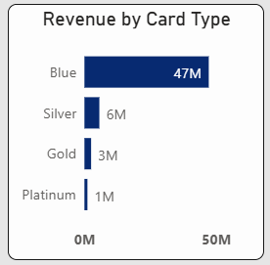
Product Analysis
There is Four Type of Card :
Blue
Silver
Gold
Platinum
Blue Card: Highest performing, contributing $47M in revenue.
Silver Card: Second highest, contributing $6M in revenue.
Gold & Platinum Cards: Contribute a smaller share of total revenue.
Insight: Blue and Silver cards together generate over 90% of total revenue, showing strong customer preference for standard card types.
Recommendation: Introduce premium benefits or cashback offers for Gold and Platinum cards to increase adoption and revenue diversification.

Slide 7
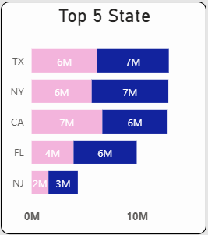
Regional Insights
The Top 5 Revenue-Contributing States are:
Texas (TX): $13M
New York (NY): $13M
California (CA): $13M
Florida (FL): $10M
New Jersey (NJ): $5M
Observation: TX, NY, and CA are the top-performing states, together contributing the majority of total revenue.
Recommendation: Focus marketing and promotional campaigns in Florida and New Jersey to improve their performance and balance regional growth.

Slide 8
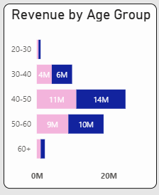
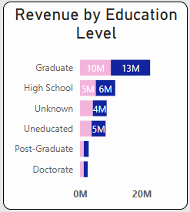
Demographic Insights (Part 1 – Age & Education)
Age Group Performance
40–50 age group generates the highest revenue ($25M).
Followed by 50–60 ($19M) and 30–40 ($10M).
Indicates strong engagement from middle-aged customers with stable income levels
Education Level Performance
Graduates lead with $23M in revenue.
Followed by High School ($11M) and Unknown ($9M) categories.
Suggests that educated customers are more active in credit card usage and spending.
Insight: Focus marketing on educated professionals aged 30–60, as they represent the
most profitable group.

Slide 9
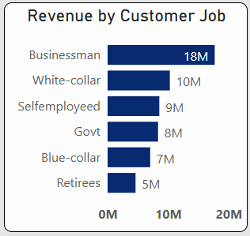
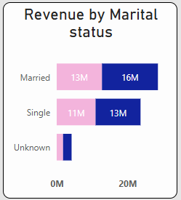
Demographic Insights (Part 2 – Occupation & Marital Status)
Occupation-wise Revenue
Businessmen: $18M
White-collar professionals: $10M
Self-employed: $9M
Government & Blue-collar workers: $7–8M
Retirees: $5M
Indicates strong engagement from business and corporate professionals.
Marital Status Revenue
Married customers: $29M
Single customers: $24M
Married customers show higher spending, likely due to shared household expenses.
Insight: Offer family-based rewards, business travel perks, and professional credit
benefits to enhance engagement among these key segments.

Slide 10
Operational Metrics
Activation Rate: 57.5% — indicates more than half of customers actively use their cards.
Delinquency Rate: 6.06% — needs improvement to reduce defaults.
Total Revenue: $57M
Interest Earned: $8M
Transaction Amount: $46M

Slide 11
Recommendations
1. Increase Card Activation
Run onboarding or reward campaigns (e.g., cashback or bonus points for first use).
Send activation reminders via SMS/email to inactive users.
2. Reduce Delinquency Rate
Implement automated payment reminders and credit alerts.
Offer flexible payment options or low-interest EMIs to reduce defaults.
3. Diversify Card Portfolio
Introduce new premium or cashback cards to balance reliance on Blue and Silver cards.
Add exclusive benefits for Gold and Platinum cardholders.
4. Expand Regional Presence
Strengthen marketing in lower-performing regions (like Florida and New Jersey).
Use local partnerships and campaigns to increase engagement.
5. Enhance Customer Retention
Launch loyalty programs and tiered rewards to encourage repeat usage.
Offer personalized offers based on spending patterns and demographics.
6. Focus on Data-Driven Decisions
Continue monitoring real-time KPIs through Power BI dashboards.
Use insights to adjust marketing, credit risk, and product strategies dynamically.

Slide 12
Business Conclusion
The Credit Card Financial Dashboard provides valuable insights into revenue trends, customer behavior, and operational performance.
It highlights that Blue and Silver cards dominate revenue generation, while middle-aged, educated, and married customers form the key customer base.
With an activation rate of 57.5% and delinquency rate of 6.06%, the business shows healthy growth but still has room for improvement in customer engagement and risk management.
Overall, the dashboard enables data-driven decision-making, helping the company enhance profitability, reduce risk, and identify new growth opportunities.

Slide 13
About the Analyst
Prepared by: Neha Pal
Data Analyst | Power BI, SQL, Excel, Python
LinkedIn: www.linkedin.com/in/nehapal3355
Email: neha.pal.3355@gmail.com
Github: https://github.com/DoogoPal

